Slide 1

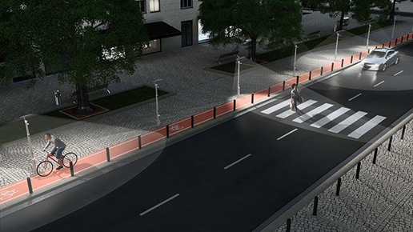
INTRA Department PROJECT on AUTOMATIC STREET LIGHT CONTROL
Under The Esteemed Guidance Of :-
Dr. N.Ananda Rao
Presented by:-
P.Vaseema (201FA05071)
Monu kumar (201FA05092)
Nitish kumar (201FA04433)
Dipu kumar (201FA04432)

Slide 2
Contents
Abstract
Introduction
Existing system
Proposed system
Component of Proposed system
Circuit diagram
Outputs
Advantage
Disadvantage
Conclusion
References

Slide 3
Abstract
This project aims at designing and executing the advanced development in embedded systems for energy saving of street lights.
Nowadays, human has become too busy, and is unable to find time even to switch the lights wherever not necessary.
The present system is like, the street lights will be switched on in the evening before the sun sets and they are switched off the next day morning after there is sufficient light on the roads.
Also, the manual operation of the lighting system is completely eliminated.

Slide 4
Introduction
In our country, the corporation Street Light Consumes more power when roads are desolate. However with the importance for saving power and proper maintenance are leads to save the natural resources for the future.
A smart Street Light System can reduce the power of corporation Street Light for desolate roads.
In our project gives the solution to those problems. An Automatic Street Light System using IR Sensors for implement a system. The LDR (Light Dependent Resistor) Sensing the weather condition.

Slide 5
Existance System
The current system of street lights consists of manual controls which need Human intervention to work upon.
This cause the loss of energy due to manual control, or the use of outdated technology.
Due to manual system one needs to turn the street lights ON or there is a time allotted during which the intensity of the system keeps on high and then turns the lights OFF when the sun rises up.

Slide 6
PROPOSED SYSTEM
This can be done by creating a new system which is Automated, Energy conserving and cheap.
This system will eliminate the system of manual control as the system will cause to light up when the ultrasonic value become less than our defined value.
Also, the light will automatically switch OFF when detected value of ultrasonic become greater than the defined value.
If the motion is detected here the intensity of light become greater for the particular time interval.
If our system found wastage of light in roads then the whole system are dim.

Slide 7
Components
Hardware
Arduino Mega
IR Sensor
LDR
LED
Software
Embedded C

Slide 8
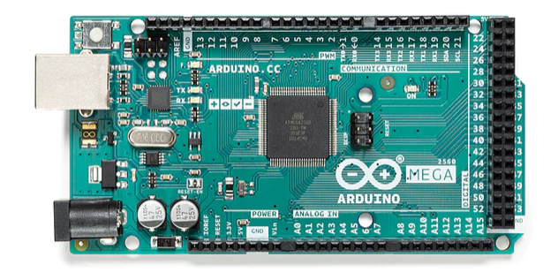
ARDUINO MEGA
Arduino mega is a microcontroller board based on the ATmega2560. It has 54 digital input/output pins (of which 6 can be used as PWM outputs),16 analog inputs, a 16MHz quartz crystal, a USB connection, a power jack, an ICSP header and a reset button. It contains everything needed to support the microcontroller.

Slide 9
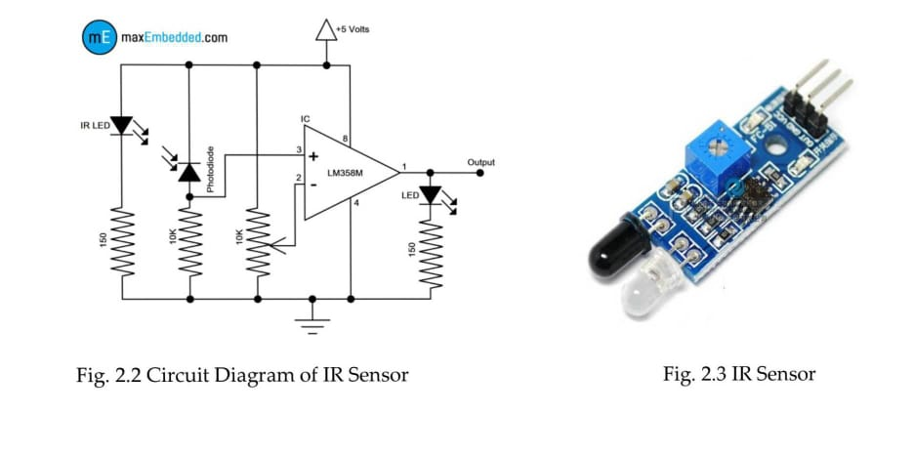
IR-Sensor
An infrared sensor is an electronic device that emits in order to sense some aspects of the surroundings.
An IR sensor can measure the heat of an object as well as detects the motion as well as the presence of an object due to intervention or interruption.
These type of sensors measure only infrared radiation, rather than emitting it that is called as a passive ir sensor.
Usually in the infrared spectrum, all the objects radiate some form of thermal radiations. These types of radiations are invisible to our eyes that can be detected by an infrared sensor.

Slide 10
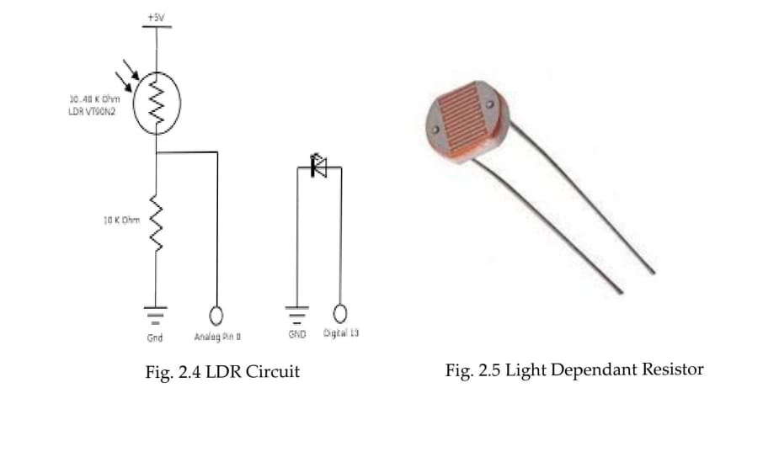
Light dependent resistor(LDR)
The LDR is a variable resistor whose resistance decreases with the increase in light intensity.
Two cadmium photoconductive cells with spectral response are very similar to that of the human eye.
The cell resistance falls with increasing light intensity.
Some of its features:
1) High reliability.
2) Light weight.
3) Wide spectral response.
4) Wide ambient temperature range.

Slide 11
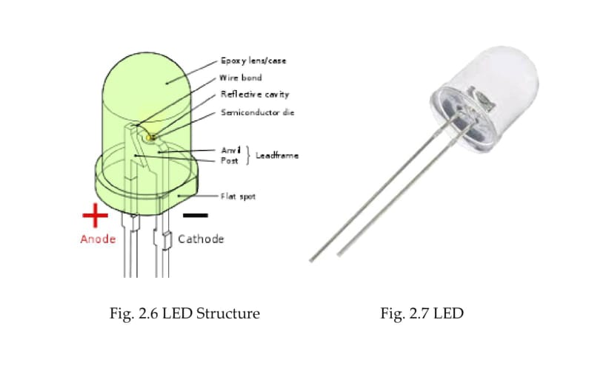
Light Emitting Diode (LED)
A light-emitting diode (LED) is a two-lead semiconductor light source. It is p-n junction diode that emits light when activated.The long terminal is positive and the short terminal is negative.
Led works on electroluminescence.
Led produce a focused light source and extra care should be used for your eyes ,though intensity is not very high.
While testing the led a resistance must be applied to it. Also, being a semiconductor device, they are sensitive to static charges.

Slide 12
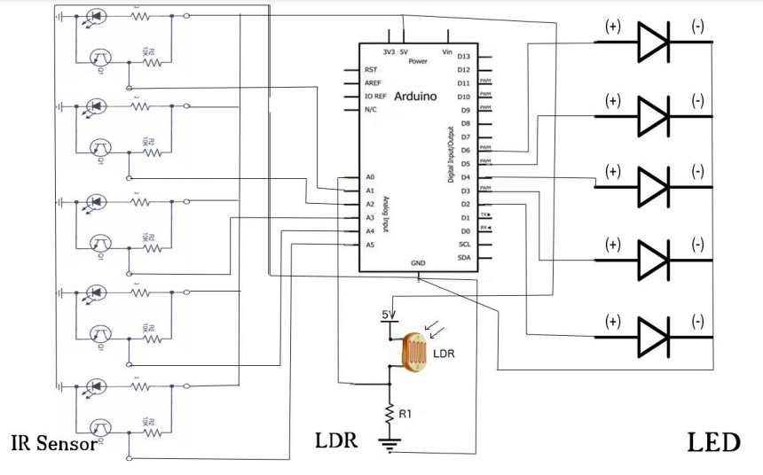
Circuit Diagram

Slide 13
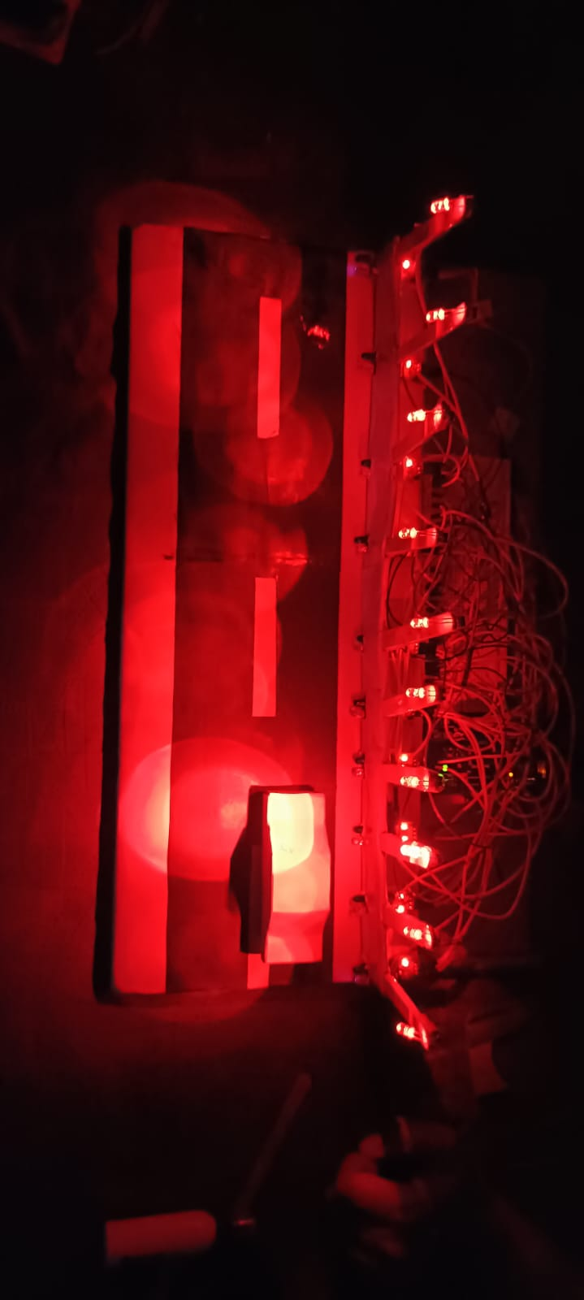
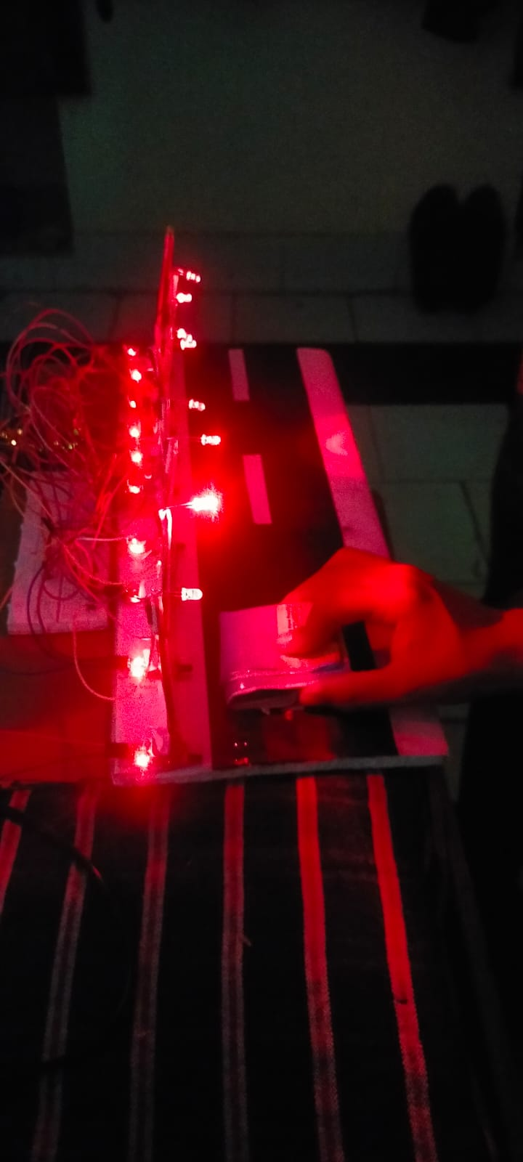
OUTPUTS

Slide 14
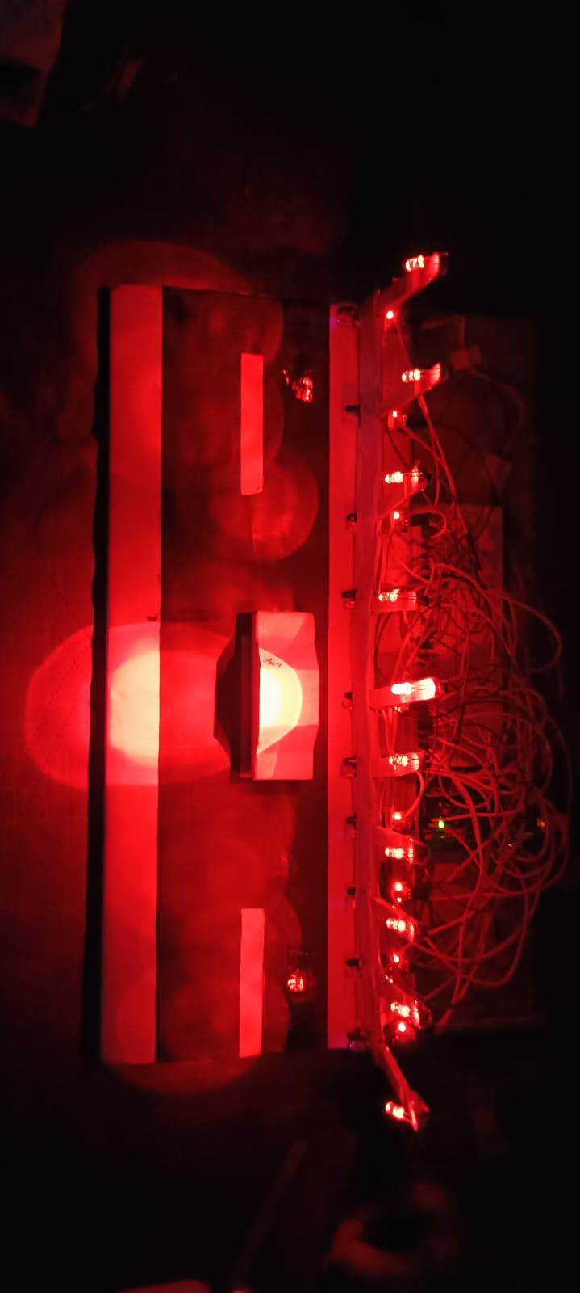

Slide 15
ADVANTAGE AND DISADVANTAGE
ADVANTAGE
The street light control circuit can be used in normal roads, highways, express ways etc.
The project can also be used in parking areas of malls, hotels, industrial lighting, etc.
As the lights are automatically turned ON or OFF, huge amount of energy can be saved.
This system less costly, less installation and maintenance cost and more efficient as compared to the others system.
DISADVANTAGE
This system can be used for only one way traffic. A highway might be covered by this system on dual system installation on both side.
Pole damage detection with the addition of suitable sensor can be implemented.

Slide 16
CONCLUSION
This project aims to find the solution of power consumption and manual working of the current system.
As we have aimed this project is working as expected in both forms i.e in university roads and in streets.
This system overcomes the drawback of current system of manual operation.
The light remains OFF or in Dim state as long as the motion is not detected. Once the motion is detected the lights comes to ON or bright state.
This system is solely made for using in a wide scale project. Also, it is very cheap.

Slide 17
REFERENCES
Payal Rodi, Leena Chandrakar, Saylee Ginde Sivanantham S and Sivasankaran K, “Energy Conservation using Automatic Lighting System using FPGA”, International Confernece on Green Engineering and Technologies, 2015.
Deepak Kumar Rath,” Arduino Based: Smart Light Control System”, International Journal of Engineering Research and General Science Volume 4, March- April, 2016.
Gouthami. C, Santosh. C, A. Pavan Kumar, Karthik. A, and Ramya.K.R, “Design and Implementation of Automatic Street Light Control System using Light Dependent Resistor”, International Journal of Engineering Trends and Technology (IJETT) – Volume 35 Number 10 - May 2016.

